Slide 1
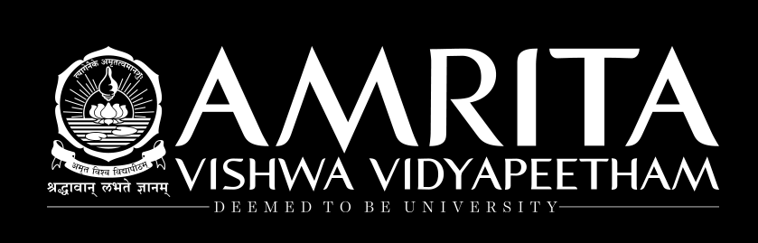
Decision Trees

Slide 2
Introduction
Decision tree is one of the most widely used and practical methods for supervised learning.
It can be used for both classification and regression tasks.
The goal is to create a model that predicts the value of a target variable by learning simple decision rules inferred from the data features.
The output is a set of rules
The decision rules are generally in form of if-then-else statements.
It is a tree-like graph with
Nodes representing the place where we pick an attribute and ask a question;
Edges represent the answers to the question;
Leaves represent the actual output or class label.
The deeper the tree, the more complex the rules and fitter the model.

Slide 3
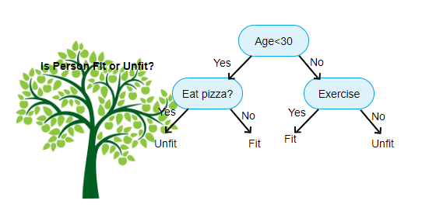
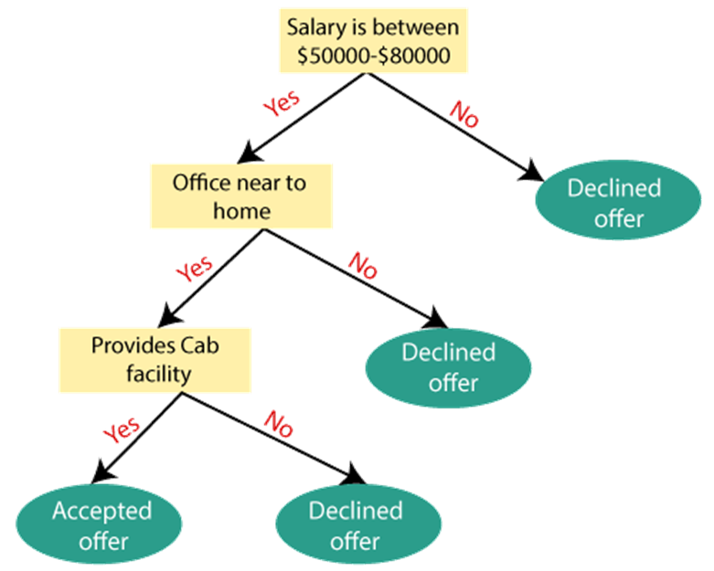
Overview

Slide 4
Goal: Classify the response to a JOB offer as “Accept JOB offer” or “Reject JOB offer”, based on ‘Compensation Offered’ and ‘Location’
Rule might be
“IF (Offer >= 10 Lakh) AND (Location = Bangalore)
THEN Accept Offer
“If (Offer < 10 Lakh) AND (Location = Bangalore)
THEN Reject Offer
…..
Such rules are best captured by tree diagrams

Slide 5
Terminologies
Root Node: Root node is from where the decision tree starts. It represents the entire dataset, which further gets divided into two or more homogeneous sets.
Leaf Node: Leaf nodes are the final output node, and the tree cannot be segregated further after getting a leaf node.
Splitting: Splitting is the process of dividing the decision node/root node into sub-nodes according to the given conditions.
Branch/Sub Tree: A tree formed by splitting the tree.
Pruning: Pruning is the process of removing the unwanted branches from the tree which reduces the impact of overfitting.
Parent/Child node: The root node of the tree is called the parent node, and other nodes are called the child nodes.

Slide 6
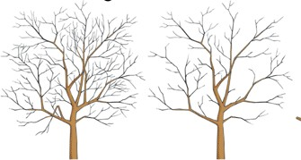

Pruning
Pruning reduces the impact of overfitting
Allowing the tree to grow to the full extent, then prune it back
Generate successively smaller trees by pruning leaves
At each pruning stage, multiple trees are possible
Use cost complexity to choose the best tree at that stage

Slide 7
Divide and conquer
Decision trees classify the examples by sorting them down the tree from the root to some leaf node, with the leaf node providing the classification to the example.
Each node in the tree acts as a test case for some attribute, and each edge descending from that node corresponds to one of the possible answers to the test case.
This process is recursive in nature and is repeated for every subtree rooted at the new nodes.
Recursive partitioning: Repeatedly split the records into two parts so as to achieve maximum homogeneity of outcome within each new part

Slide 8
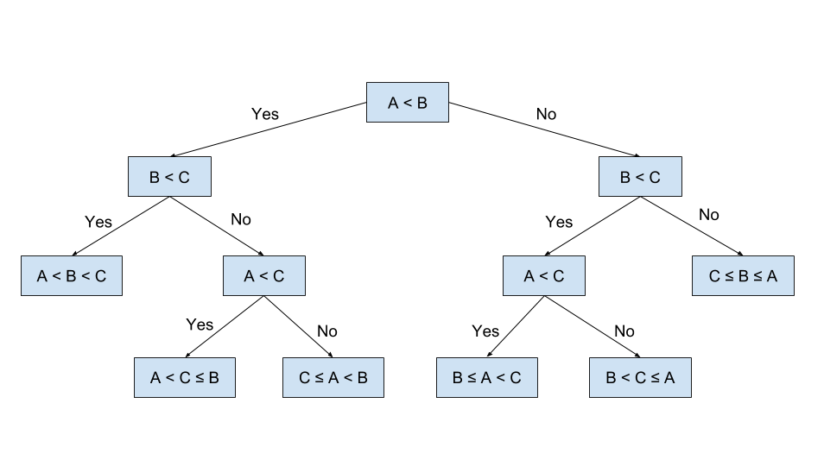
Programming viewpoint

Slide 9
Real life example
Assume that you want to play badminton on a particular day. How will you decide whether to play or not?
Factors influencing the decision – Weather, temperature, humidity, wind.
Day | Weather | Temperature | Humidity | Wind | Play?
1 | Sunny | Hot | High | Weak | No
2 | Cloudy | Hot | High | Weak | Yes
3 | Sunny | Mild | Normal | Strong | Yes
4 | Cloudy | Mild | High | Strong | Yes
5 | Rainy | Mild | High | Strong | No
6 | Rainy | Cool | Normal | Strong | No
7 | Rainy | Mild | High | Weak | Yes
8 | Sunny | Hot | High | Strong | No
9 | Cloudy | Hot | Normal | Weak | Yes
10 | Rainy | Mild | High | Strong | No

Slide 10
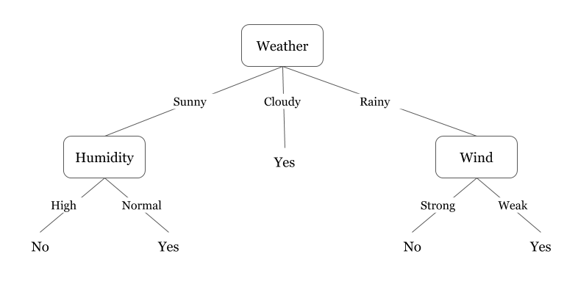
Real life example
Now, you may use this table to decide whether to play or not.

Slide 11
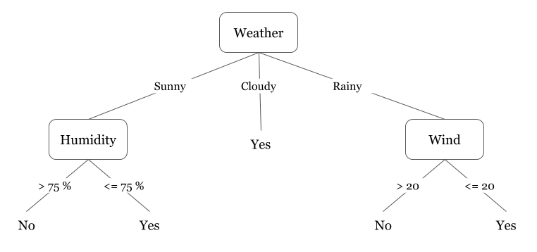
Real life example
We can see that each node represents an attribute or feature and the branch from each node represents the outcome of that node. Finally, its the leaves of the tree where the final decision is made.

Slide 12
Algorithm
A general algorithm for a decision tree can be described as follows:
Steps
Pick the best attribute/feature. The best attribute is one which best splits or separates the data.
Ask the relevant question.
Follow the answer path.
Go to step 1 until you arrive to the answer.
The best split is one which separates two different labels into two sets.

Slide 13
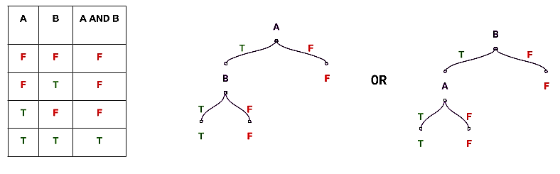
Expressiveness of decision trees
Let’s use decision trees to perform the function of three Boolean gates AND, OR and XOR.
We can see that there are two candidate concepts for producing the decision tree that performs the AND operation.

Slide 14
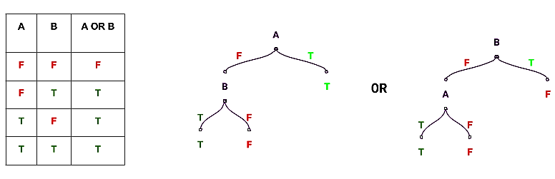
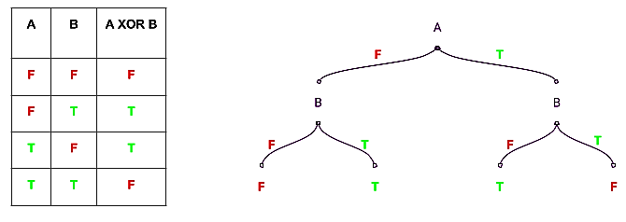

Slide 15
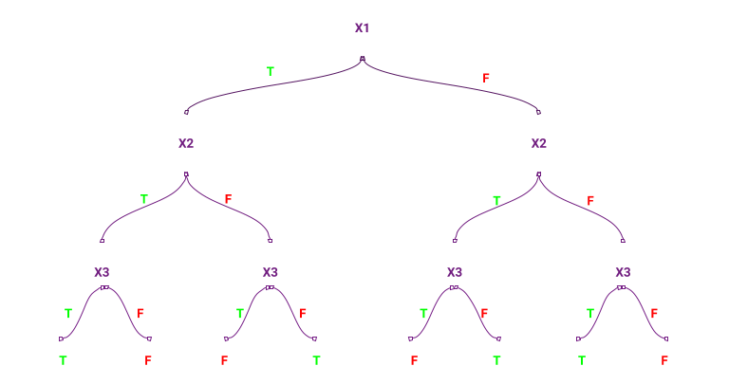
Let’s produce a decision tree performing XOR functionality using 3 attributes:

Slide 16
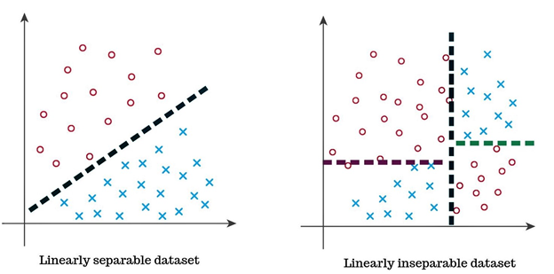
Separability

Slide 17
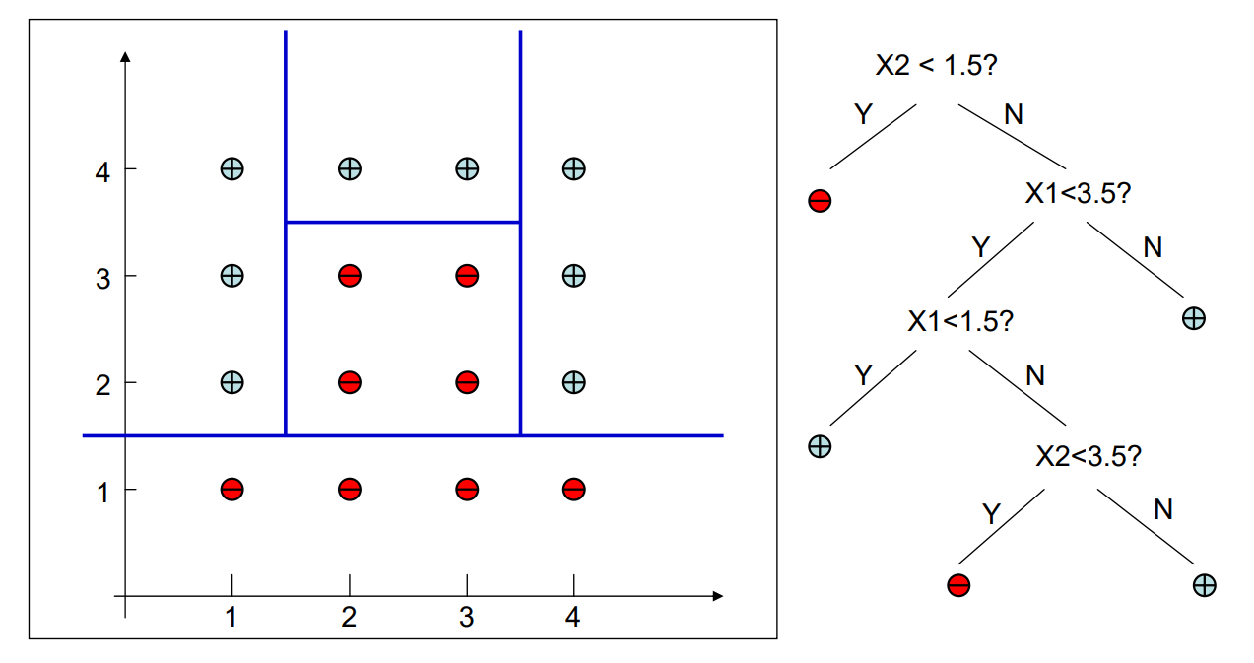
Decision tree boundary

Slide 18
Learning algorithm
The basic algorithm used in decision trees is known as the Iterative Dichotomiser 3(ID3) algorithm.
The ID3 algorithm builds decision trees using a top-down, greedy approach.
Steps
Select the best attribute → A
Assign A as the decision attribute (test case) for the NODE.
For each value of A, create a new descendant of the NODE.
Sort the training examples to the appropriate descendant node leaf.
If examples are perfectly classified, then STOP else iterate over the new leaf nodes.

Slide 19
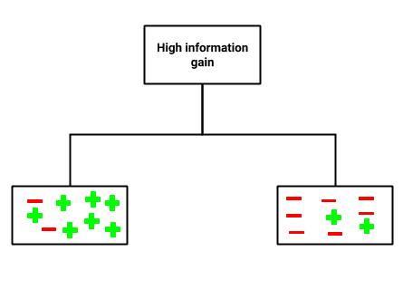
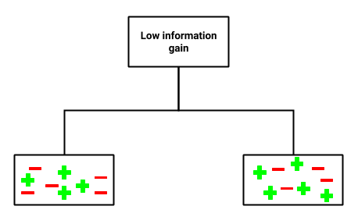
Selecting the best attribute
The best attribute is the one with the highest information gain.
Information gain: A measure that expresses how well an attribute splits that data into groups based on classification.
An attribute with low information gain splits the data relatively evenly and as a result doesn’t bring us any closer to a decision.
Whereas, an attribute with high information gain splits the data into groups with an uneven number of positives and negatives.

Slide 20
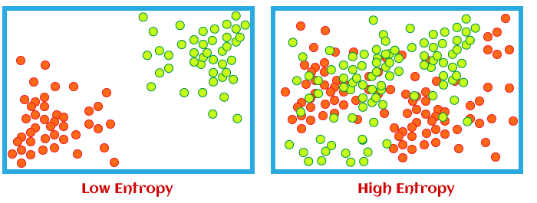
Information Gain
To define information gain precisely, we need to define a measure commonly used in information theory called entropy that measures the level of impurity/disorder in a group of examples.

Slide 21

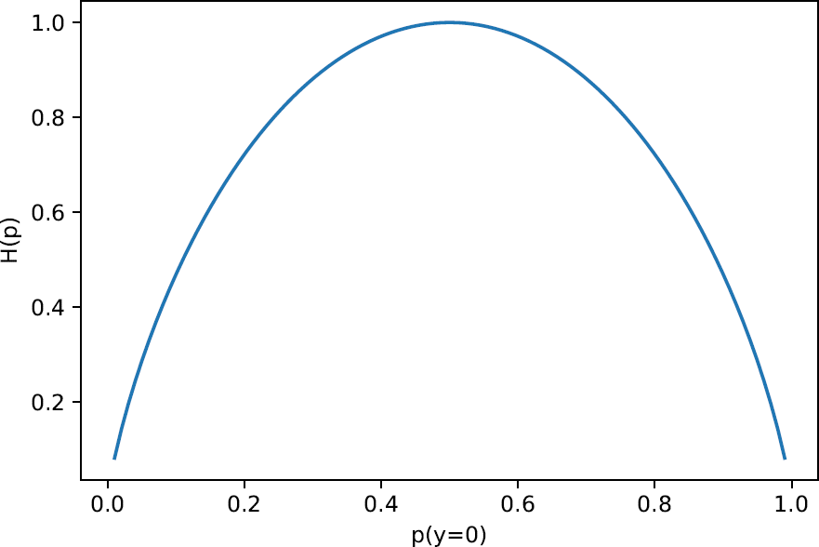
Mathematically, entropy is defined as:
Since, the basic version of the ID3 algorithm deal with the case where classification are either positive or negative, we can define entropy as :
where,
S is a sample of training examples
p₊ is the proportion of positive examples in S
p_ is the proportion of negative examples in S
Entropy ranges between 0 (most pure) and log₂(m) (equal representation of classes)
Implying for a 2 class scenario (m=2) with equal representation, entropy would be log₂(2) = 1

Slide 22
Example
Suppose S is a sample containing 14 Boolean examples, with 9 positive (+) and 5 negative (-) examples.
Then, the entropy of S relative to this Boolean classification is:
Note that entropy is 0 if all the members of S belong to the same class.
For example, if all members are positive (p₊=1), then p_ is 0, and Entropy(S) = -1 * log₂(1) -0 * log₂(0) = 0.
Entropy is 1 when the sample contains an equal number of positive and negative examples.
If the sample contains unequal number of positive and negative examples, entropy is between 0 and 1.
Entropy (S) = -(9/14) * log₂(9/14) - (5/14) * log₂(5/14) = 0.9

Slide 23
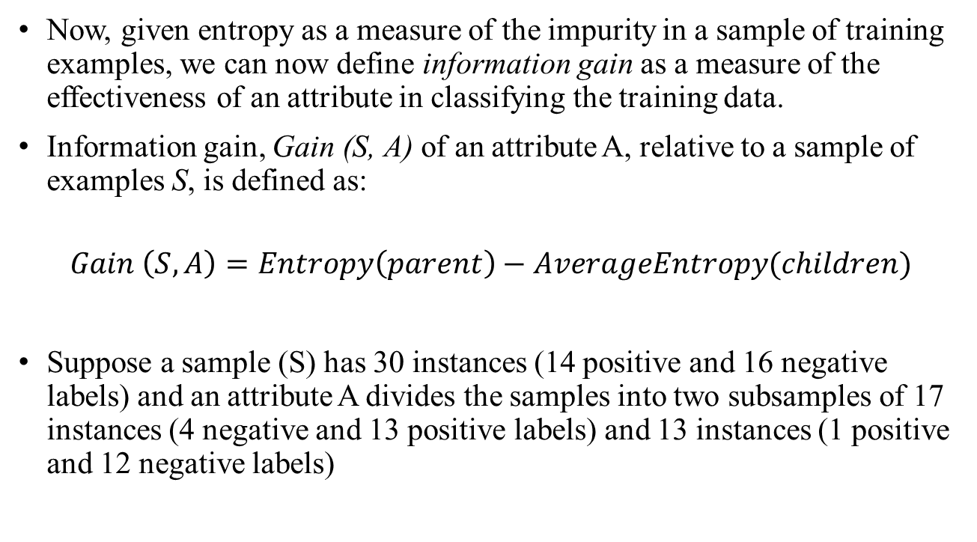

Slide 24
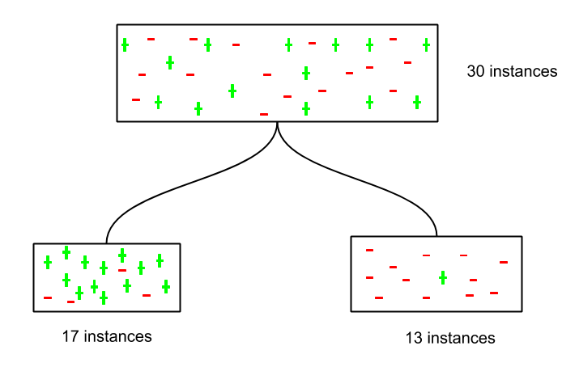

Slide 25
Let’s calculate the information gain of the attribute A.
Entropy (parent) = -14/30 * log₂14/30 – 16/30 * log₂16/30 = 0.996
Entropy (child with 17 instances) = -13/17 * log₂13/17 – 4/17 * log₂4/17
= 0.787
Entropy (child with 13 instances) = -1/13 * log₂1/13 – 12/13 * log₂12/13
= 0.391
Average Entropy of children = 17/30 * 0.787 + 13/30 * 0.391
= 0.615
Information Gain = G(S, A) = 0.996 - 0.615 = 0.38

Slide 26
Splitting Criteria
Obtain overall impurity measure (weighted avg. of individual rectangles)
Entropy
Gini Index
Misclassification Error
At each successive stage, compare this measure across all possible splits in all variables
Choose the split that reduces impurity the most
Chosen split points become nodes on the tree

Slide 27
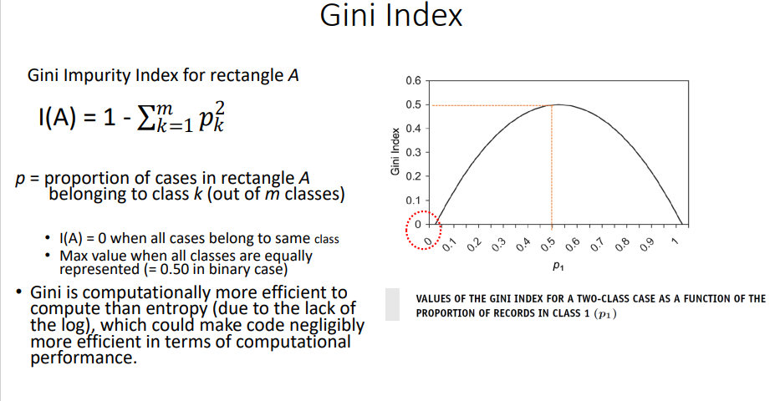

Slide 28
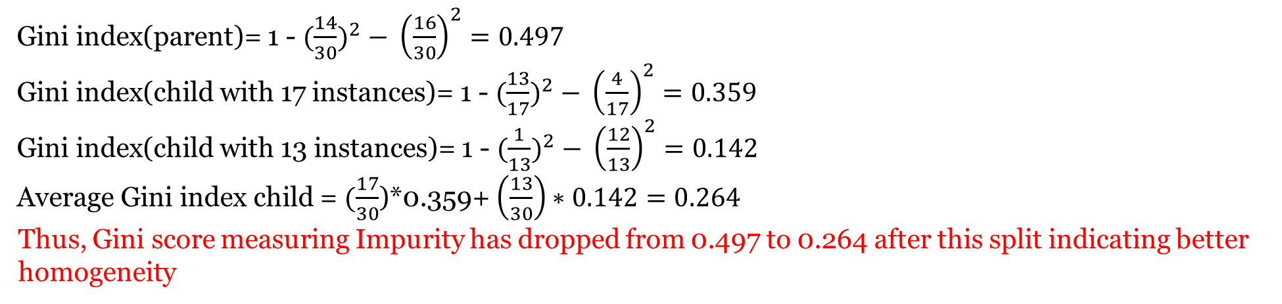
Gini index(parent)= 1 - ${(\frac{14}{30})}^{2} − {\left(\frac{16}{30}\right)}^{2}=0.497$
Gini index(child with 17 instances)= 1 - ${(\frac{13}{17})}^{2} − {\left(\frac{4}{17}\right)}^{2}=0.359$
Gini index(child with 13 instances)= 1 - ${(\frac{1}{13})}^{2} − {\left(\frac{12}{13}\right)}^{2}=0.142$
Average Gini index child = $(\frac{17}{30}$)*0.359+ $\left(\frac{13}{30}\right)∗0.142=0.264$
Thus, Gini score measuring Impurity has dropped from 0.497 to 0.264 after this split indicating better homogeneity

Slide 29
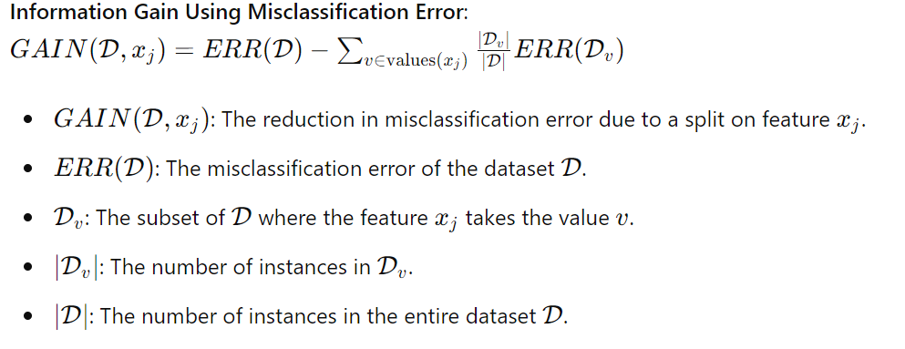
Misclassification Rate- Another Splitting Criteria

Slide 30
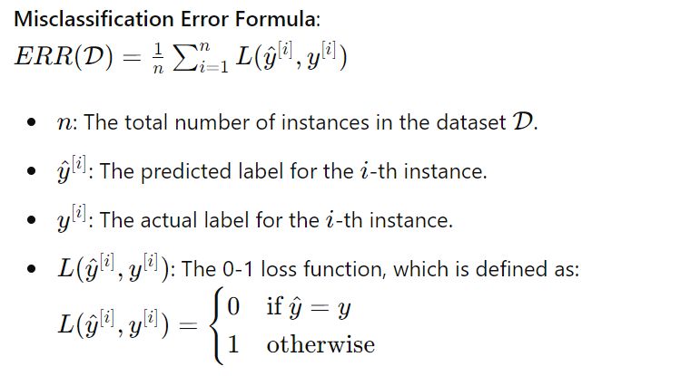

Slide 31
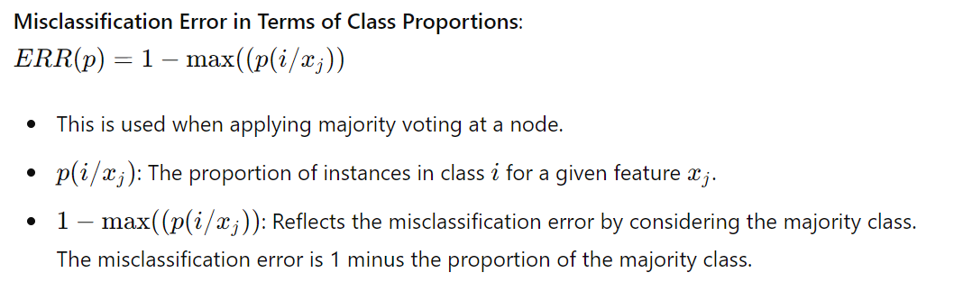

Slide 32
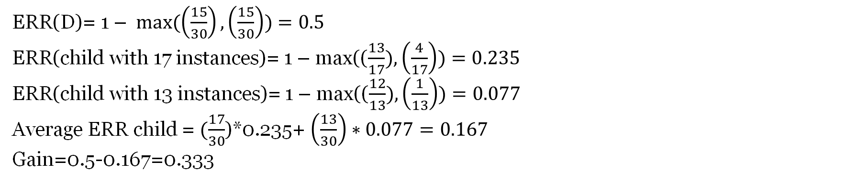
ERR(D)= 1 – $max⁡(\left(\frac{15}{30}\right),\left(\frac{15}{30}\right))=0.5$
ERR(child with 17 instances)= 1 – max(($\frac{13}{17}),\left(\frac{4}{17}\right))=0.235$
ERR(child with 13 instances)= 1 – max(($\frac{12}{13}),\left(\frac{1}{13}\right))=0.077$
Average ERR child = $(\frac{17}{30}$)*0.235+ $\left(\frac{13}{30}\right)∗0.077=0.167$
Gain=0.5-0.167=0.333

Slide 33
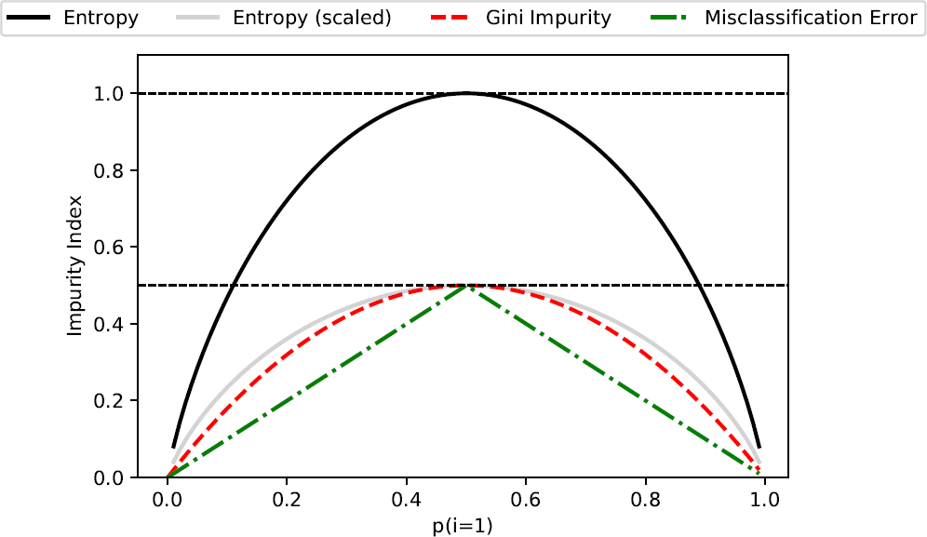
Comparison of different impurity measures.

Slide 34
